Slide 1
Sakai (Admin)

Slide 2
List of menu
Overview
Users
Aliases
Sites
Realms
Worksite Setup
MOTD
Resources
Online
Memory
Site Archive
Job Scheduler
Become User
Preferences
User Membership
Help

Slide 3
Users
Includes 3 main functions
New User
Import From File
Search

Slide 4
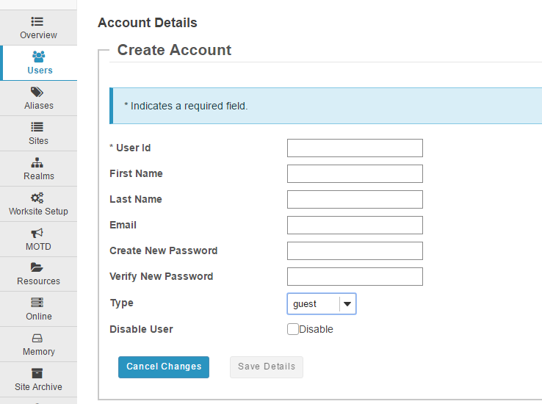
(1) New User
Can create new user account according to 3 different types (guest, maintain, registered).

Slide 5
(2) Import From File
Select a CSV file containing the details of the users you wish to create.
File requirements
Include the following headings: user id, first name, last name, email, password, type.
Column headings must match EXACTLY the list above. They do not need to be in the same order.
Fields must be comma separated, contain no spaces between fields and each field surrounded with double quotes if it is to contain a space.
You can also add other columns and these will be stored as user properties, as long as the headings do not clash with the main set above. It can be any arbitrary data.

Slide 6
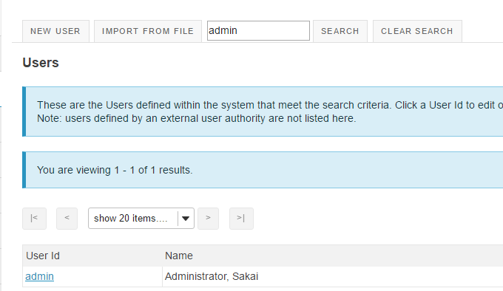
(3) Search
These are the Users defined within the system that meet the search criteria. Click a User Id to edit or view detail.
Users defined by an external user authority are not listed.

Slide 7
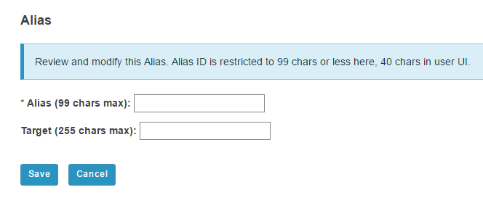
Alias
This section has the same function as the Users except importing CSV.

Slide 8
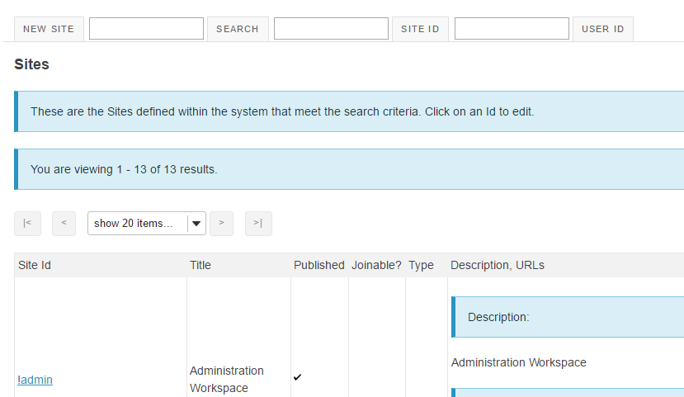
Sites
Includes 2 functions, creating new site and search site by site ID or site name.

Slide 9
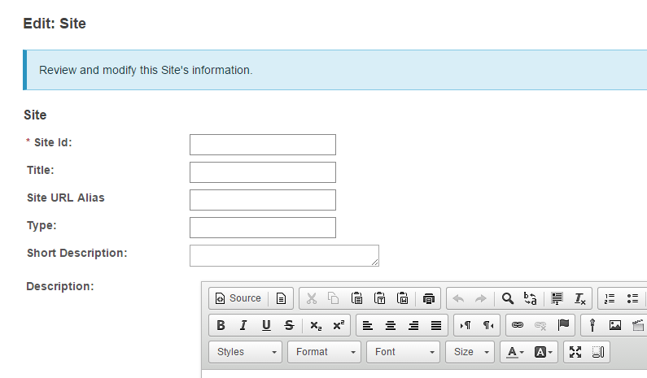
(1) New Site

Slide 10
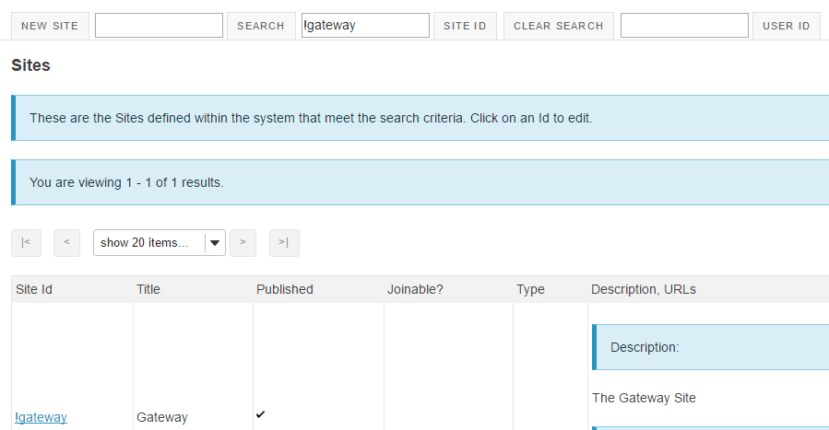
(2) Search Sites

Slide 11
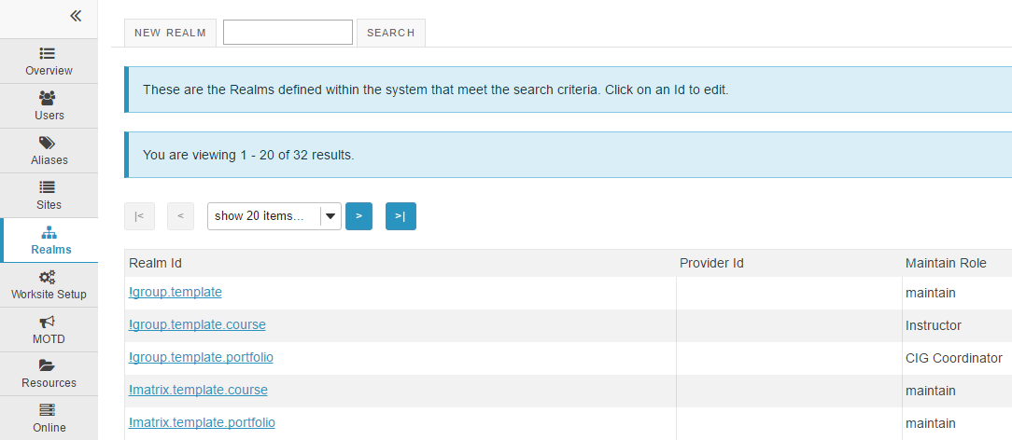
Realms

Slide 12
Worksite Setup
Can edit, delete, hard delete.
To edit, need to check the worksite you want to edit.
If delete is clicked, 'softly deleted' but will remain accessible to you via the "View softly deleted Sites" option in the Worksite Setup tool which is found in Home. Participants will no longer be able to access the site, however the contents of the site will be preserved and you can restore access to the site at any time before it is purged.
Hard-Deleting a site removes the entire site's content and is not recoverable - no one else will be able to access the deleted site. If you are trying to remove yourself from the site, use the Membership tool in your Home to unjoin the site.

Slide 13
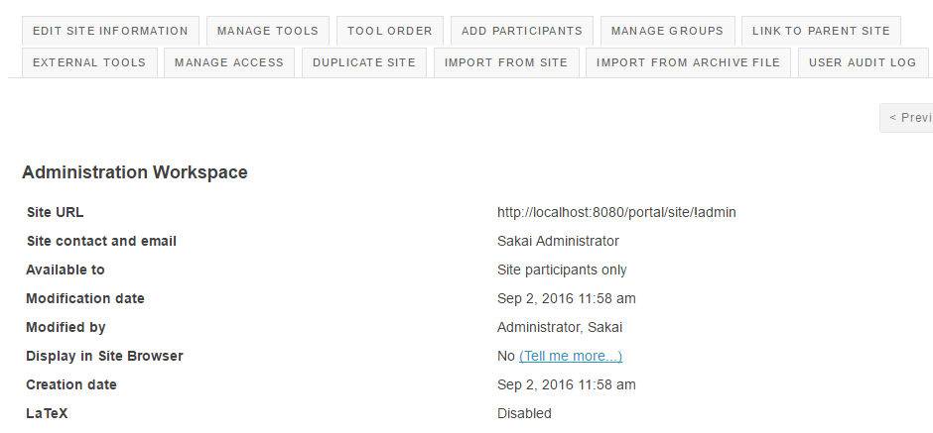
(1) Edit Worksite
Functions including in editing worksite are : edit site information, manage tools, tool order, add participants, manage groups, link to parent site, external tools, manage access, duplicate site, import from site, import from archive file, user audit log.

Slide 14
Functions in Editing Worksite
Edit Worksite Information can edit site language, short description, icon URL, site contact name, and site contact Email.
Manage Tools can choose tools to include in your site such as Assignments tool, Calendar tool, Chat Room tool, etc..
Order Tools can change tool order. When deleting or editing a tool name, changes will take effect immediately.
Add Participant includes adding email address of official and non-official participants, choosing participant roles and status.

Slide 15
Cont’d
In Manage Groups, you can create new group, create new joinable set, auto groups, import from file.
Link to Parent Site is linking to a parent site and user will see the navigation showing site links between the parent and child sites.
External Tools is for installing the tool and then to launch the tool, you need to create a tool configuration for the tool.
Manage Access can change access for administration workspace such as site status, site visibility, and global access.

Slide 16
Cont’d
Duplicating a site will create a new site with content that owners/admin created, but for privacy reasons will not copy items added to the site by general users.
Import from Site has three methods to import data, by replacing data, merging data and merging user(s).
Import from Archive File needs to choose a file to import materials.

Slide 17
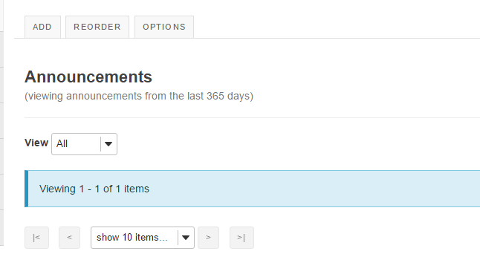
MOTD
MOTD is viewing announcements, adding, reordering, and setting options for announcements.

Slide 18
Resources
It shows site resources and can transfer files.
Transferring files allow you to drag and drop files and folders between your computer and this site’s resources tool.
Site resources show resources, can move, copy, move to trash, show, hide, make web content links of folders.

Slide 19
Online
Shows the state of current running applications such as locations, sessions, servers.
You can manual refresh and auto refresh to running servers.

Slide 20
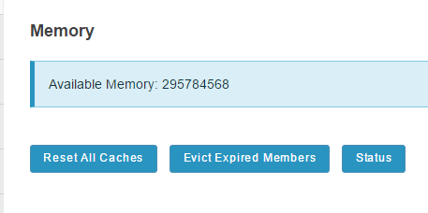
Memory
Memory shows the available memory.

Slide 21
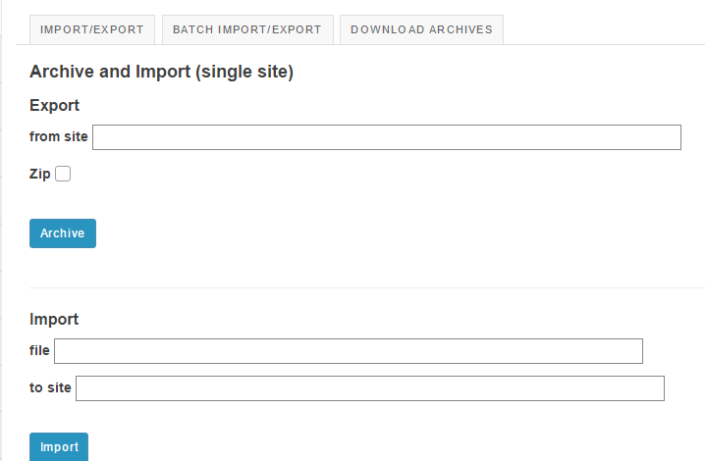
Site Archive
Site Archive can import/export, batch import/export, and download archives.

Slide 22
Job Scheduler
Table of today’s events, jobs, and running jobs.
JOBS can create new job, delete jobs, and view running jobs.

Slide 23
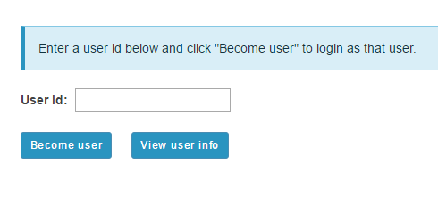
Become User
Need to enter a user id and click “Become User” to login as that user.

Slide 24
Preferences
Controls notifications setting, time zone, language, sites.
Can hide the site from a site drawer from selecting a site or grouping of sites.

Slide 25
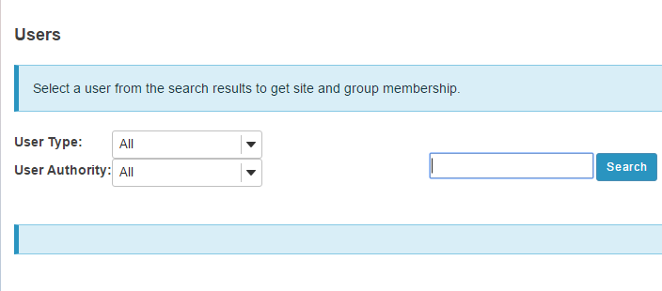
User Membership
Select a user from the search results to get site and group membership.

